Slide 1
IoT Based Garage Door Opener: Interfacing BBB with ESP32 Wifi Module
Shivinder Kaur (C0751078)
Group 4

Slide 2
Content
Task Objective
Components Required
Introduction to Beaglebone Black
Specifications of Beaglebone Black
Pin Configuration of Beaglebone Black
Introduction to ESP32 Wifi Module
Function Block Diagram
Pinout of ESP32
Features & Specifications of ESP32
Schematic of Beaglebone Black and ESP32
Code
References

Slide 3
Task Objective
The main objective of this task is to interface Wifi Module ESP32 with Beaglebone Black.
To establish the proper connections between ESP32 and Beaglebone Black
To get the coding done in the way that ESP32 will communicate with Beaglebone Black.

Slide 4
Components required:
Hardware Components:
Beaglebone Black
ESP32 Wifi Module
Connecting Wires
USB cable
Software Components:
Linux Operating System
Terminal nano
GCC Compiler
Latest image of debian for beaglebone black
C programming

Slide 5
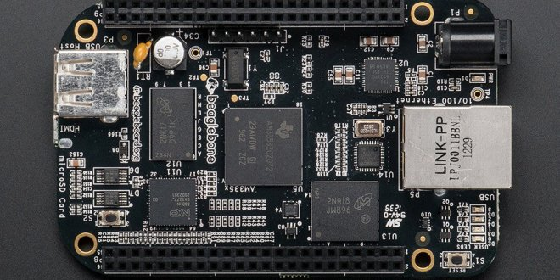
Introduction to Beaglebone Black
The Beaglebone Black is a low-cost embedded linux computer which consists of absurd amount of input and output pins, along with several interfaces that allow different devices to be connected and different communication protocols to be used.

Slide 6
Specifications of Beaglebone Black
Processor | Sitara AM3358, 1GHz ARM®️ Cortex-A8
GPU | SGX530 3D
SDRAM Memory | 512MB DDR3L 800MHz
Onboard Storage | 4GB
MicroSD | MicroSD Card Slot
USB 2.0 Client | Mini USB
USB 2.0 Host | Dual USB Connector
Video/Audio Output | Micro-HDMI
Ethernet | 10/100, RJ45
Power Source | Mini USB or 5V DC jack
Operating System | Linux, Debian

Slide 7
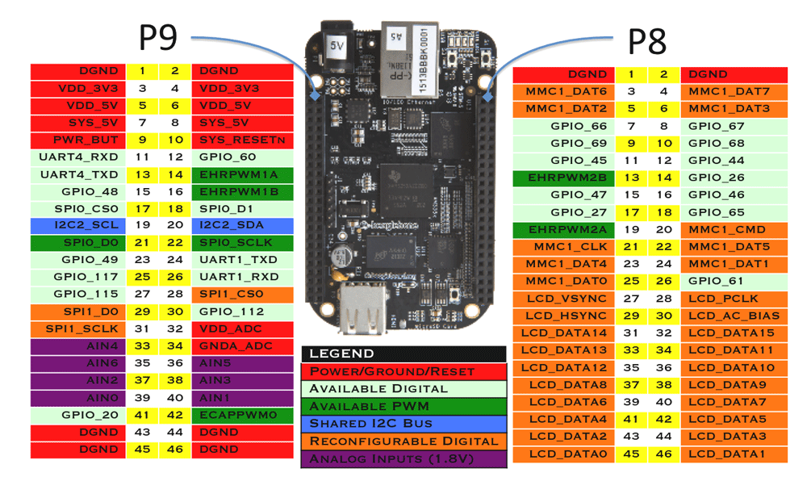
Pin Configuration

Slide 8
Introduction to ESP32 Wifi Module
ESP32 is a low-cost, low-power system on a chip (SoC) series with Wifi & dual-mode Bluetooth capabilities.
The ESP32 family includes other chips as well such as ESP32-D0WDQ6 (and ESP32-D0WD), ESP32-D2WD, ESP32-S0WD, and the system in package (SIP).
There is a dual-core or single core Tensilica Xtensa LX6 microprocessor with a clock rate of upto 240 MHz.
ESP32 is highly integrated with built-in antenna switches, RF balun, power amplifier, low-noise receive amplifier, filters and power management modules.

Slide 9
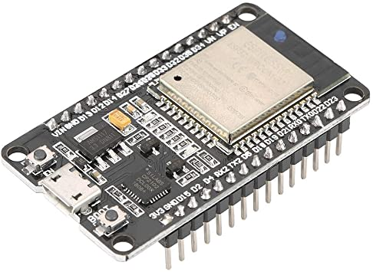
Introduction to ESP32 Wifi Module

Slide 10
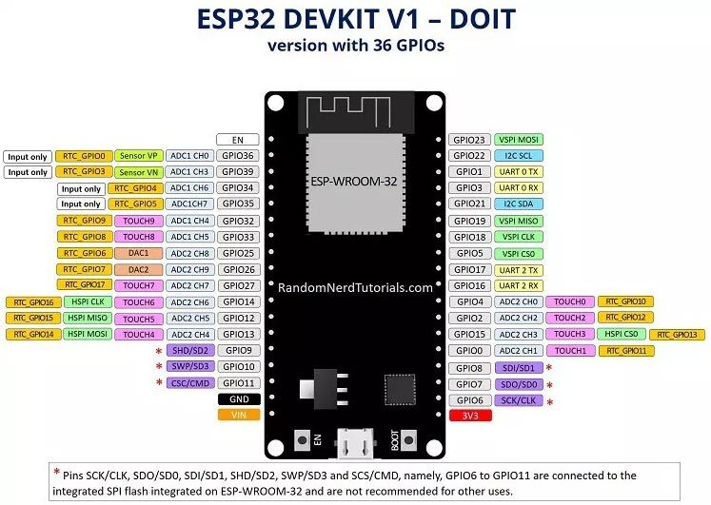
Pinout of ESP32 Wifi Module

Slide 11
Features & Specifications:
Processors: Main Processor: Tensilica Xtensa 32-bit LX6 microprocessor Cores: 2 or 1 (depending on variation) Clock Frequency: upto 240 MHz Performance: upto 600 DMIPS Ultra low power co-processor: allows you to do ADC conversions, computation, and level thresholds while in deep sleep.
Wireless Connectivity: Wifi: 802.11 b/g/n/e/i (802.11n @ 2.4 GHz upto 150 Mbit/s) Bluetooth: v4.2 BR/EDR and Bluetooth Low Energy (BLE)

Slide 12
Features & Specifications:
Memory: Internal memory: ROM: 448 KiB For booting and core functions SRAM: 520 KiB For data and instructions RTC fast SRAM: 8 KiB For data storage and main CPU during RTC Boot from the deep-sleep mode RTC slow SRAM: 8 KiB For co-processor accessing during deep-sleep mode eFuse: 1 Kibit Of which 256 bits are used for the system (MAC address and Chip configuration) and the remaining 768 bits are reserved for customer applications, including Flash- Encryption and Chip-ID Embedded Flash: Flash connected internally via IO16, IO17, SD_CMD, SD_CLK, SD_DATA_0 and SD_DATA_1 on ESP32-D2WD and ESP32-PICO-D4.

Slide 13
Features & Specifications:
External flash & SRAM: ESP32 supports upto four 16MiB external QSPI flashes and SRAMs with hardware encryption based on AES to protect developers’ programs and data. ESP32 can access the external QSPI flash and SRAM through high-speed caches. Upto 16 MiB of external flash are memory-mapped onto the CPU code space, supporting 8-bit, 16-bit and 32-bit access. Code execution is supported. Upto 8MiB of external flash/SRAM memory are mapped onto the CPU data space, supporting 8-bit, 16-bit and 32-bit access. Data-read is supported on the flash and SRAM. Data-write is supported on SRAM.

Slide 14
Features & Specifications:
Peripheral input/output: Rich peripheral interface with DMA that includes Capacitive touch, ADCs(Analog to Digital Converters), DACs(Digital to Analog Converters), I2C(Inter-Integrated Circuit), UART(Universal Asynchronous receiver/transmitter), CAN 2.0(Controller Area Network), SPI(Serial Peripheral Interface), I2S(Integrated Inter-IC Sound), RMII(Reduced Media Independent Interface), PWM(Pulse Width Modulation) and more.

Slide 15
Features & Specifications:
Security: IEEE 802.11 standard security features all supported, including WFA, WPA/WPA2 and WAPI. Secure boot Flash encryption 1024-bit OTP, up to 768-bit for customers. Cryptographic hardware acceleration: AES, RSA, SHA-2, elliptic curve cryptography (ECC), random number generator (RNG).

Slide 16
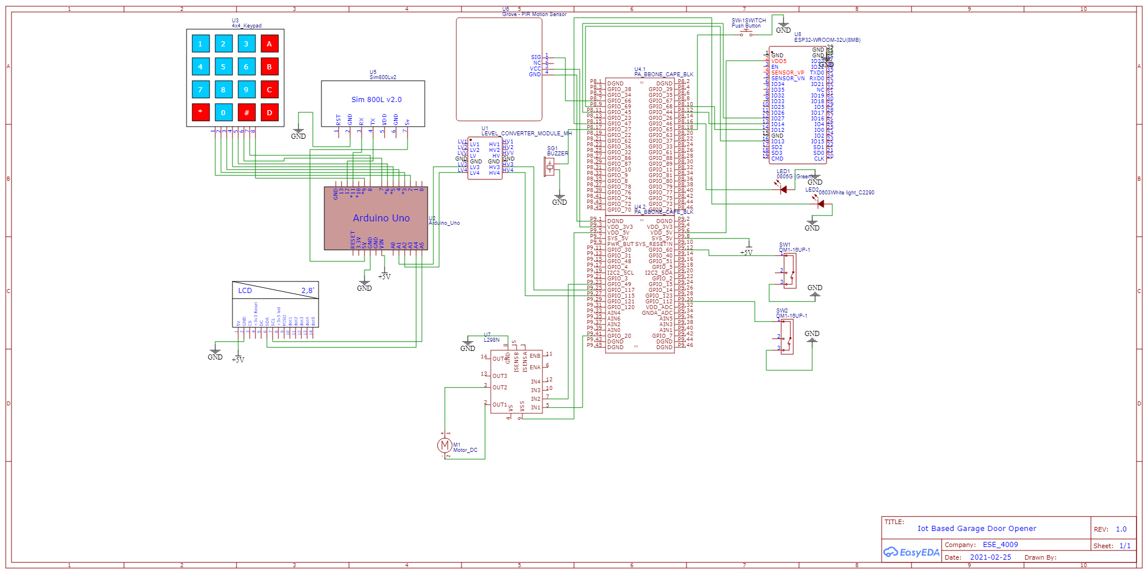
Schematic of Beaglebone Black and ESP32
ESP32 wifi module | Beaglebone Black
D12 | GPIO_68(P8.10)
D13 | GPIO_69(P8.9)
D14 | GPIO_44(P8.12)
D27 | GPIO_45(P8.11)
5V | 5V
GND | GND

Slide 17
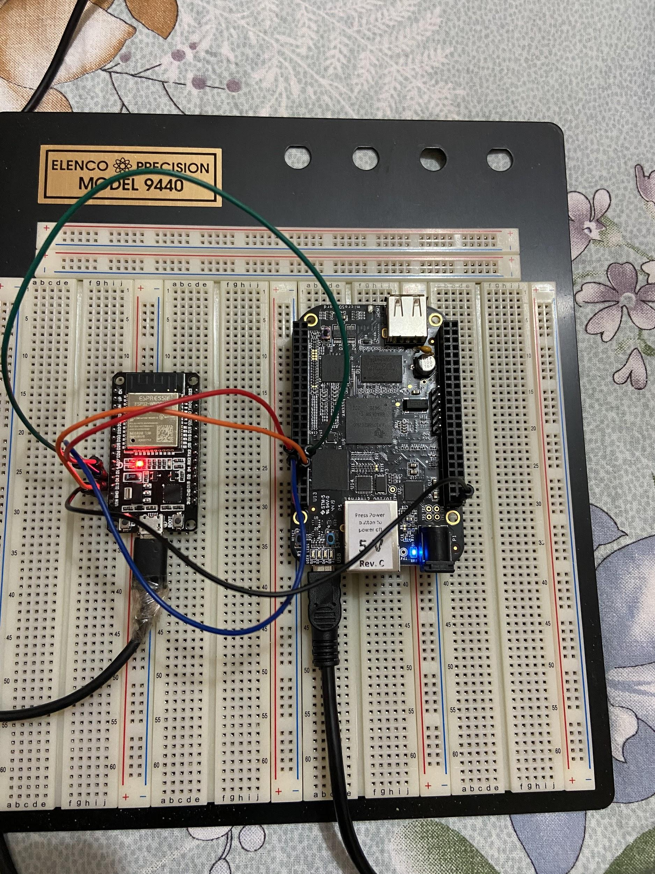
Connection of Beaglebone Black with ESP32

Slide 18
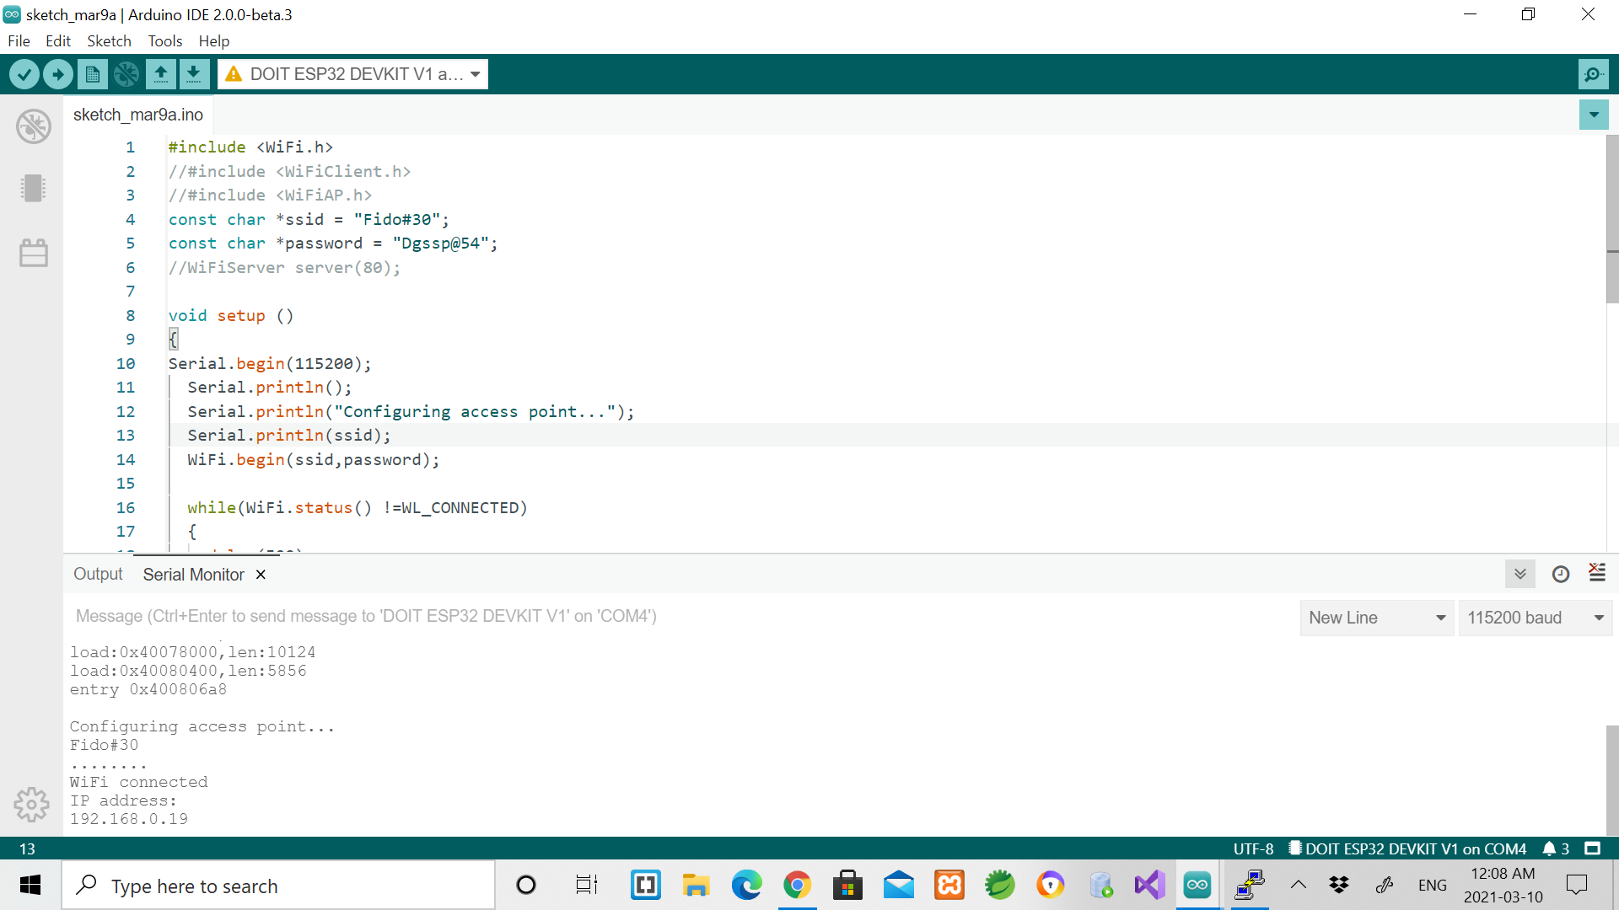
Coding of ESP32 in Arduino IDE

Slide 19
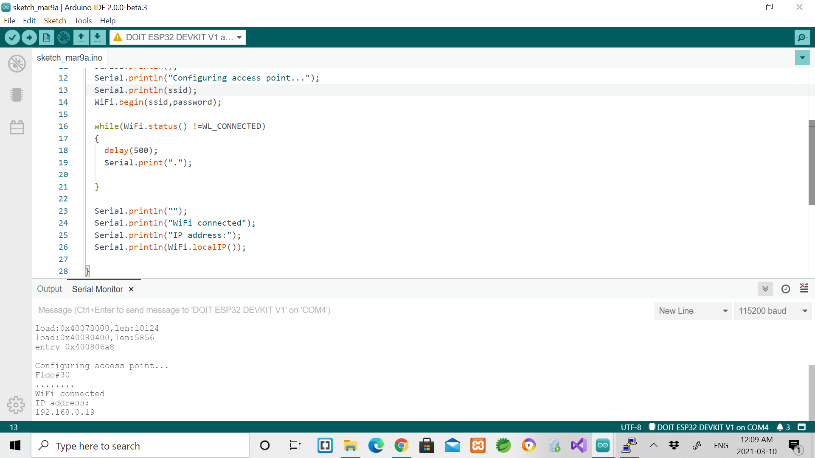
Coding of ESP32 in Arduino IDE

Slide 20
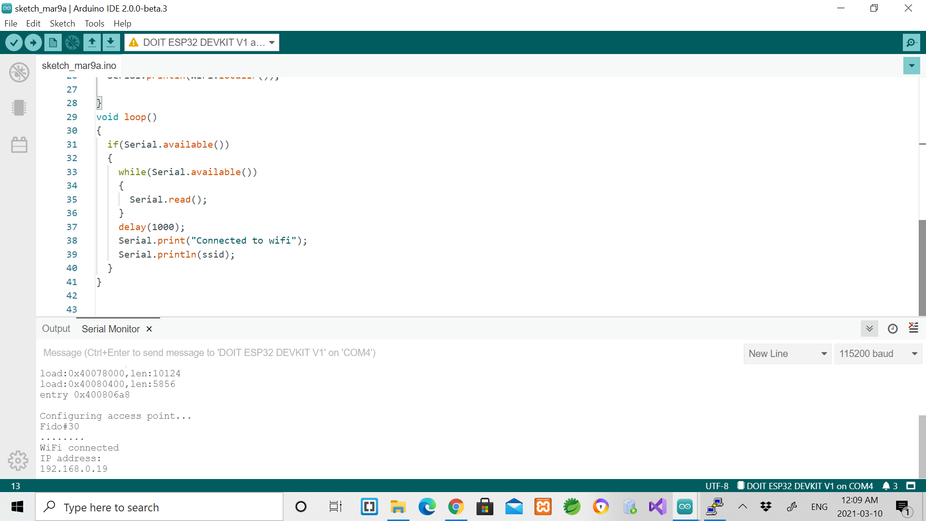
Coding of ESP32 in Arduino IDE

Slide 21
Coding of ESP32 in Arduino IDE
#include <WiFi.h>
const char *ssid = "Fido#30";
const char *password = "Dgssp@54";
void setup ()
{
Serial.begin(115200); // set the Baud rate at 115200
Serial.println(); //prints data to the serial port
Serial.println("Configuring access point...");
Serial.println(ssid);
WiFi.begin(ssid,password); //connecting to Wifi

Slide 22
Coding of ESP32 in Arduino IDE
while(WiFi.status() !=WL_CONNECTED) //while loop to wait until the Wifi is
not connected
{
delay(500);
Serial.print("."); //this will display when there is no connection
}
Serial.println("");
Serial.println("WiFi connected"); //wifi connection message
Serial.println("IP address:");
Serial.println(WiFi.localIP()); // displays IP address
}

Slide 23
Coding of ESP32 in Arduino IDE
void loop()
{
if(Serial.available()) //if data is coming from serial
{
while(Serial.available())
{
Serial.read();
}
delay(1000);
Serial.print("Connected to wifi");
Serial.println(ssid);
}
}

Slide 24
References:
Retrieved from Random Nerd Tutorials, URL: https://randomnerdtutorials.com/getting-started-with-the-beaglebone-black/
Retrieved from teach me micro, URL: https://www.teachmemicro.com/beaglebone-black-hardware/
Retrieved from esp32.net, URL: http://esp32.net/
Retrieved from Industrial Shields, URL: https://www.industrialshields.com/blog/arduino-industrial-1/post/wifi-bluetooth-module-esp32-133
Retrieved from github, URL: https://github.com/gov466/Capstone-project/blob/master/interfacing%20of%20ESP8266%20with%20BBB/Arduino%20code%20for%20ESP8266

